Slide 1

IRONHACK
The CV of a Career Changer into Tech
Notes:
Hello Ironhacker, in this workshop we’re going to share some of the best insights we’ve gathered throughout the years working with thousands of Ironhackers who, just like you - decided to switch careers and do a 180 degree change to their lives and careers. Oh, and don’t worry - if you’re a Career booster, you will also learn lots so pay good attention.

Slide 2

Think as if your CV was
A LANDING PAGE
Promoting one product
YOU.
Notes:
During this workshop, we are inviting you to imagine your CV as if it was a landinga page or a website - promoting one product or service: YOU. Highlighting your education, your experience, your skills and motivations.
By now, you probably already know what are some of the most important things to take into account when either designing, coding, using or testing a website.
It needs to be well thought through especially if it’s selling a product or a service, because you want to sell it right?
And of course the content, structure, design, the Call to Actions, the SEO will be crucial
So we’re going to take care of all these things while working on our CV.

Slide 3
Let’s get started!
IRONHACK 2023. ALL RIGHTS RESERVED.
Notes:
So without further ado - let’s get started with some of the basic rules to have a killer CV!

Slide 4
RULE NUMBER ONE
Know your desired outcome
IRONHACK 2023. ALL RIGHTS RESERVED.
Notes:
As said, every website has a reason to exist. It normally promotes or sells a product or a service, and for that to happen - it’s important that we know exactly what we want the user to do (reading this or that, clicking here or there, etc.) So, what do you definitely wish users to do before moving away from your CV?

Slide 5

What do you want recruiters to do?
☎️
📧
Email you
Call you
🖱️
🗂️
Save your CV for later
Click through
Notes:
So, what do you definitely wish recruiters to do when they check your CV? What are the actual actions you want them to take? Well, easy peasy.
You want them to call you, email you, click through to your LinkedIn profile, GitHub, medium, portfolio, one of your projects, etc.
And if for whatever reason none of these actions take place, you want them to at least save your CV for a future role that better fits your profile.
To summarise, if at least one of these actions take place - it means that they’ve liked what they’ve seen right??? It’s a good sign!!!
Later on you will understand that the location of this information on your CV will play a key role. (Next) RULE NUMBER TWO

Slide 6
RULE NUMBER TWO
Know your audience
IRONHACK 2023. ALL RIGHTS RESERVED.
Notes:
Knowing your audience will help you tremendously when building your CV! The more you know about them, the better you will be able to just provide them with what they need! So let’s dive a bit deeper into understanding them. Let’s find out!
Can you already guess who will be the number 1 reader of your CV?????????
Do you know what their day-to-day life looks like? Or what they're looking for when checking your CV?
Let’s find out!

Slide 7


<80% an IT Recruiter
Write / re-write job descriptions
Post job openings on career sites
Proactively seek candidates via LinkedIn, etc.
Review CV’s/resumes received from candidates
Screen candidates
Respond to emails, arrange/conduct interviews
Write/present candidate profiles to teams…
Notes:
80% of the time your number one audience type will be an IT recruiter. There are different types of recruiters depending on the company type or size (i.e. there can be in-house or external recruiters, etc.). Regardless of this, these are crucial stakeholders throughout the hiring process with quite important decision power.
Some of the many things that they do is what you see written on this slide. Generally, recruiters get a brief from the technical team or the client, including a description of the vacancy, the role and responsibilities, the minimum requirements they look for on a candidate, deadlines, etc. But it’s the recruiter who finishes writing or rewriting the job offer including information regarding the company, the perks, etc. They are the ones posting it on the different job portals and social media platforms. Also who proactively seek candidates via LinkedIn, Indeed and other platforms - review CV’s, cover letters received, screen them, respond to hundreds of emails, arrange or conduct interviews, reject or recommend candidates to the following stages of the recruitment process. These are only some of the things that recruiters do on their day to day.

Slide 8

More about IT Recruiters
They are extremely busy people
They see hundreds of CV's a week!
They use specific recruiting platforms & software
They use keywords to screen through
(i.e. React, NodeJS, agile, Figma, SQL, Berlin, junior...)
They're not very technical…
Notes:
All in all, we can say that the job of a recruiter is very hard. They are extremely busy and they check hundreds of CV’s every day or week and talk to an insane amount of people (depending on the company size, the number of vacancies they have to fill, etc.)
Just like we all do when we look up something on Google, recruiters use special recruiting platforms and software and use keywords to find their ideal match. For example they could use “React - Junior - Berlin, or Figma/SQL Barcelona 1+ years of experience…)
Lastly, something interesting to know is that IT recruiters generally know only enough technical language or jargon to screen and conduct candidates, but not so much to have an in-depth technical conversation.
But, if we estimate that 80% of the time it’s a recruiter who checks our CV - who represents the remaining 20%? Can you guess?

Slide 9


<20% Hiring Managers (Senior Tech professionals)
Less used to reading CV's but will care about it!
Very technical
If you don’t have experience,
They’ll want to see projects, portfolio, GitHub, your code…
Education, certificates
Notes:
The remaining time, it will be tech professionals who will be checking our CV/LinkedIn profiles because they’re obviously also part of the hiring process. They will come into play at a later stage, after you’ve passed the first filters (CV, first HR interview…) Some of the things we know about them is that They’re obviously way more technical than recruiters because they are Senior designers, Data Scientists or Software Engineers most of the times, but they can also be CTo’s, CEO’s in startups or just senior business leaders. They are the so-called Hiring managers (mainly, your direct or indirect managers!)
So, what are they like in comparison to recruiters? What are they interested in?
Firstly, they’re generally less used to reading CV’s but they will care about it of course. So watch out to the design and content… we’ll talk about that in just a moment. Now, what they will definitely check is your projects, your portfolio, your Github, your code… that’s the meaty part they will be looking for. They will also care about your education/certificates so obviously your Ironhack bootcamp should be visible at first glance!
Now that we know more about our CV audience, let’s move on to RULE NUMBER 3!

Slide 10
RULE NUMBER THREE
Hierarchy matters
IRONHACK 2023. ALL RIGHTS RESERVED.
Notes:
As we’ve seen in the past few sections of this presentation - it’s important that we understand our objective when designing our CV’s or resumes (we want recruiters to call us, email us, see our work, etc.). Likewise, it’s important that we understand what our audience is like so that we can provide them with the right information and make their lives easier and less busy.
Some of the questions we encourage you to reflect on when designing your CV are:
What information should be visible at first glance?
What elements of my profile and experience are more relevant considering a recruiters’ goals and needs?
And based on that, what information is therefore less so important?
So yes, the way in which you structure the information will be key. So rule number three: hierarchy matters!

Slide 11
pic
Contact Details
Email
Phone
LinkedIn Profile
GitHub
Portfolio
Prioritizing information regarding your bootcamp
NAME
Professional Title
Summary: Brief recap of your skills & motivations!
Education & skills
Projects
Your Ironhack certificate is probably one of the most important achievements in regards to your new career in tech. Describe it!
Education
Name Project 1
1 Line description
Technologies used
Name Project 2
1 Line description
Technologies used
Name Project 3
1 Line description
Technologies used
Your projects
Ironhack (WD/UXUI/DA/CY)
Description of bootcamp
Technologies
Other/Highest Ed certificate
Employers are keen to see some experience on your CV. Your bootcamp projects can play a big role in showcasing what you can do!
Highlight Skills
Your professional experience
Professional Experience
If unrelated to your new career in tech, focus just on the main achievements and learnings. Keep this section in a lower section of your CV..
Tech Skills
Check job offer & edit
Soft Skills
Check job offer & edit
Language skills
Job Title Company Name & date
2-3 bullet points
Focus on facts & figures
Key achievements/skills acquired
Notes:
This is an example of a recommended CV structure if you’re a career changer - meaning that your past professional experience or education, is completely unrelated to your bootcamp. Remember, this is just an example and it doesn’t mean that there aren’t other formulas that can work out well for you. For instance, if you do have a related background, you are more than welcome to interchange or amend the hierarchy and structure here suggested. Let’s start at the very top. Depending on where you are based, you will include a picture with a professional but smiling face of yours! Your name, big and clear and your job title right beneath! By job title we mean “Junior Web Developer” or “Junior Data Analyst” or “UXUI Designer” or “Cyber security Analyst” followed by a brief summary of yourself and your motivations. Because our main goal as candidates is to get a phone call, an email or have recruiters and hiring managers to click through to our LinkedIn, Github, projects, etc. → our contact details will be placed somewhere at the top - including hyperlinks to the different sites to drive more clicks.
Interchangeably, your education and bootcamp projects are tremendously important because as at the time of your graduation - it will be the most important achievements in relation to your new career in tech! So, make sure to describe them (ideally in 2-3 bullet points to make reading easier). Your bootcamp - describe its structure and length in one bullet point and the technologies learned on another one, for example. Your skills are a fundamental part of your profile (remember recruiters use them as keywords to find you quicker) - so make sure to list your technical skills and check job offers to get an overall idea of the most important sought after soft skills such as communication, autonomy, teamwork, etc. For your projects, make sure to create a separate section for these and include your project’s title and a link to them, alongside a super brief description and technologies used to build them.
Lastly, if your professional background experience is completely unrelated to your bootcamp - allocate it on a lower section of your CV and include company name and title, alongside a brief description of your responsibilities and achievements, focusing on the skills you acquired that could potentially serve you as a new web developer, designer, or analyst.
Finally, don’t forget that this is just an example and that you might have a unique or different case, so follow our recommendations as much as possible, but add your own judgment and after working on it, request a 1-1 with your Student Success Manager to review your CV and adapt it to your particular case.

Slide 12
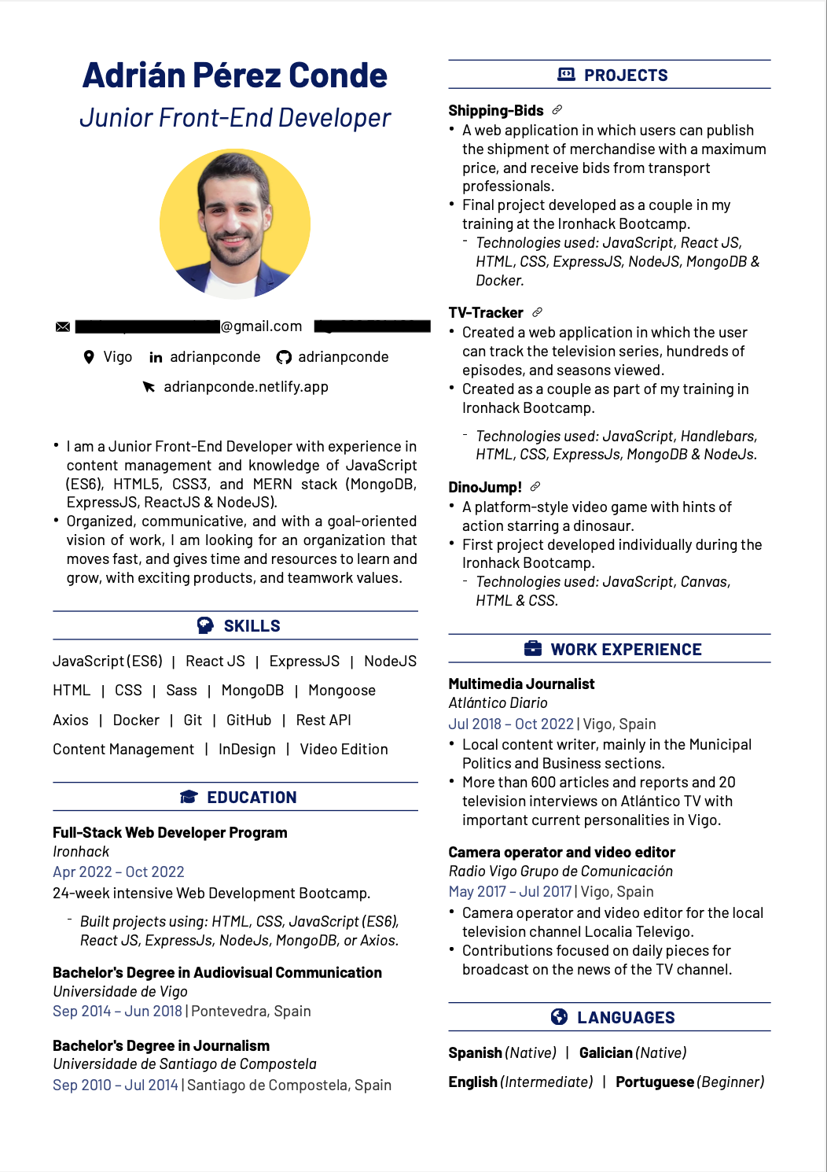
Example 1
Check Adrián’s CV and how he’s prioritised his education and projects before his professional experience as a journalist.
Notes:
Here we have one example of Adrián’s CV. Since his professional experience as a journalist isn’t necessarily relevant to his new career as a Web Developer, he decided to highlight his bootcamp and his projects instead and provide it more visibility.

Slide 13
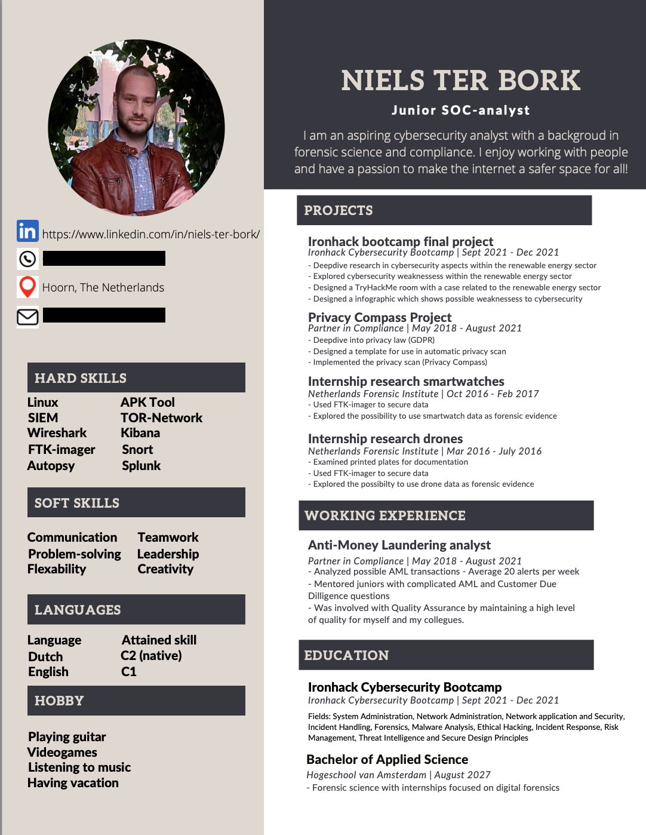
Example 2
See Nielsen’s choice? Since his background as an Anti-Money Laundering Analyst might be quite relevant to the role of a SOC analyst, he’s decided to prioritise it.
Notes:
On the other hand, Niels’ background experience as an Anti-Money Laundering Analyst may have a lot of transferable skills into SOC analyst, he’s decided to put it before his education.
As you can see, as long as you have a justification of what pieces of information you want to highlight and why - the formula can work!
Are you ready for Rule number four?

Slide 14
RULE NUMBER FOUR
Content & design are crucial
IRONHACK 2023. ALL RIGHTS RESERVED.
Notes:
Rule number four is that not only the hierarchy, but the content and the design of your CV/resume matter too because it also has a huge impact on the user experience.

Slide 15
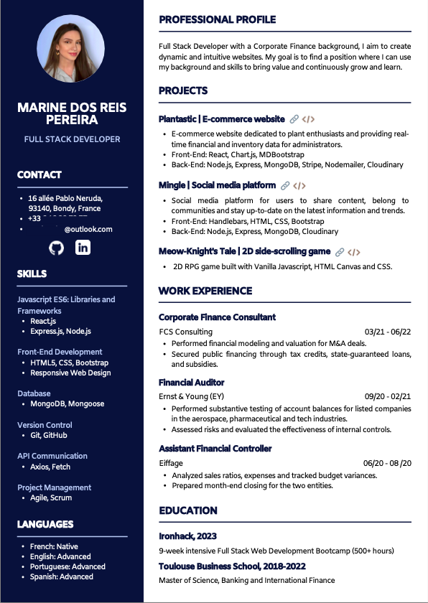
Your CV should be a teaser inviting recruiters to want to know more about you
Try to fit everything into one page
Focus on the most relevant information
Remember that your CV will be in constant change and evolution
Your Ironhack SSM will help you out!
Notes:
We don’t want to overwhelm recruiters with a huge amount of sometimes unnecessary information so for that, we encourage you to think of our CV as a teaser that urges the recruiter to click through your LinkedIn, Behance or Github profile - wanting to know more you!
First of all, try to fit all of your experience into one page. We know it might be tricky sometimes - but it all comes down to being able to synthesize your highlights in your education and professional background, making sure you focus on the most important and relevant information and not just everything you’ve done. Try to connect the dots between what you used to do before the bootcamp and your new career, and focus there.
Oh and remember that your CV will change many times from now on - so don’t worry about it too much because you will have the support of your Student Success Manager to help you focus on the important things and phrase your experience in the best way possible!

Slide 16
Some questions you can ask yourself
Is my document breathing?
Or is it full of text?
Am I overwhelming the reader with unnecessary information?
Am I putting the focus on my new career or my past one?
Are the sections in my CV clear and differentiated enough?
Using different font styles, colours, etc.
NOTE: Check some of these free CV design tools: Resume.io, Flow CV
Notes:
Here are some questions that can help you when reviewing your CV:
Is my document breathing?
Or is it full of text?
Am I overwhelming the reader with unnecessary information distracting them from the important part of my profile - which is the bootcamp, my projects, my motivations, etc.?
Am I putting the focus on my new career, or my past one?
Are the sections in my CV clear and differentiated enough?
For example, using different font styles, colours, etc.
You can of course design your own template, but you can also check these two free CV builder sites. These are ATS-friendly, meaning that the software used by recruiters can read them.

Slide 17
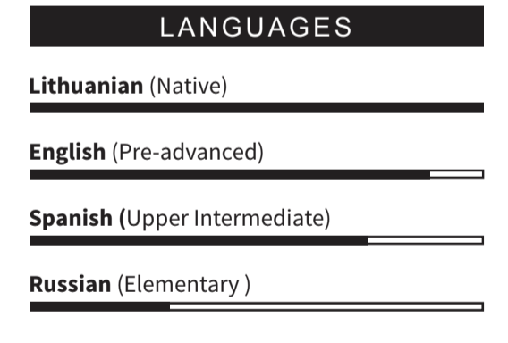
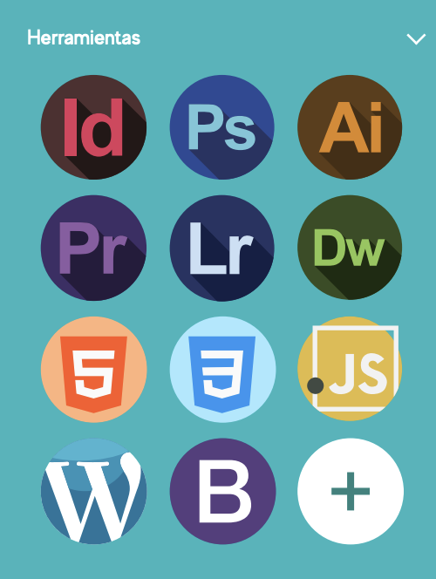

ATS-Friendly CV’s
Always have an ATS-friendly CV/Resume template. Most ATS only recognize text (. txt, . doc., . docx files). Either create it yourself, use our already-made template or use Resume.io or FlowCV.
For exceptional situations - you can have a more creative one using Canva and other similar tools, in which case - send the two versions.
Don’t measure skills like this:
Measure skills like this:
Avoid images (ATS don’t read them)
Notes:
ATS stands as an Application Tracking System and it is widely used in the recruitment industry as a software that collect, sort, scan, and rank CV’s based on a certain criteria.
The issue with ATS is that they have a hard time detecting images like logos, tables and sometimes even certain fonts or formats. In fact, they can only read text files. You should always make sure that your CV is ATS friendly and either - design one yourself, use one of our templates or find CV/resume builders that meet the requirements mentioned, such as Resume.io and FlowCV
For exceptional cases, for example if you are networking through LinkedIn or spontaneously sending your CV via email or LinkedIn message and would like to have a more creative CV - you are more than welcome to do so. But remember that in most cases, it’s important to think about this. To see some examples, it’s important that all your keywords are written in text format and not in some sort of graph like the one we’re seeing here with the languages. Neither should you use the logos of the technologies instead of actually writing them.

Slide 18
YOUR CV
From top to bottom
IRONHACK 2023. ALL RIGHTS RESERVED.
Notes:
On this part of the workshop we are going to quickly review each part of your CV and give you some great tips!
But first of all, remember that these are only overall tips and that it’s important to remember that every country has its own styles and protocols - so first do your research and double check with your Ironhack Student Success Manager to make sure you’re following the most appropriate format.

Slide 19
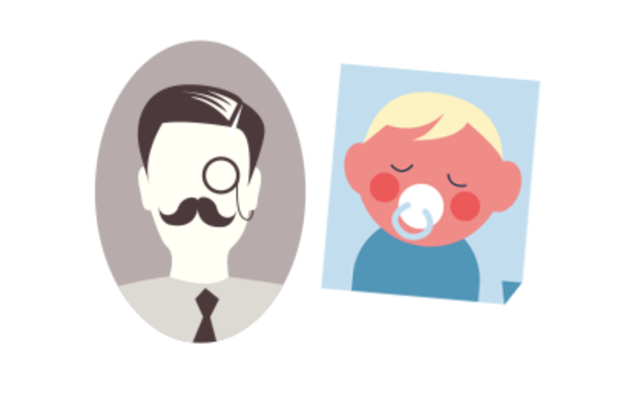






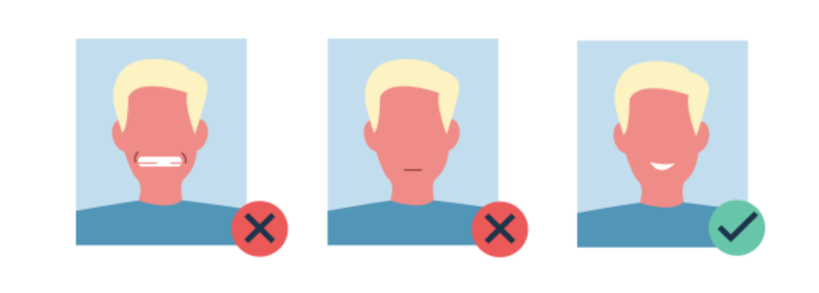


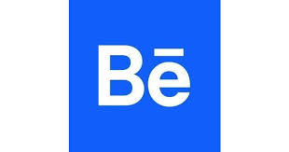



The headline
Profile picture
Contact Information
Phone
Mail
Linkedin
GitHub
Location
No too old
Smile
No selfies
Medium
Dribbble
Behance
No pixel
Be careful when editing
Check the background
Notes:
If having a profile picture is something that is popular in your country - for example Spain, Portugal, France, Germany as opposed to the UK or the US for example - then it’s important to keep an eye on a few basic things. Make sure you use a recent picture of yourself and that you are showing a friendly, smiley face! At the end of the day, people that check your CV will want to work with you so if you have a grumpy face you might be perceived as such! You can take a selfie but a such good one that it doesn’t seem like one. Otherwise you can ask a friend and make sure your face and neck is at the camera center. You don’t need to pay to have a professional picture taken, but you’re welcome to! What’s important it’s that it has good definition and that it comes across as friendly, yet fairly professional. Contact information
When it comes to your contact details, remember to put them very visible, at the top if possible and make sure that you include your Phone, Email address, LinkedIn, Github profile and location at least. Additionally, if you have a portfolio website, use medium, behance, dribble - feel free to add too. However, those 5 first data points are non-negotiable! Oh, and don’t forget to hyperlink these!

Slide 20
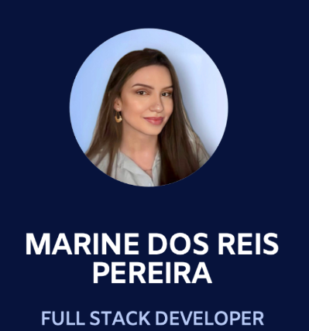
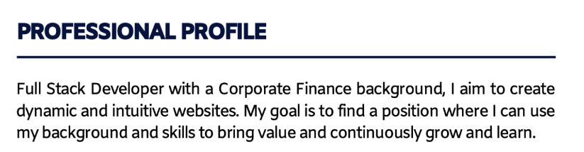
The summary
A section next your name and job title
A brief summary of your main professional highlights and motivations
Helps recruiters have a better understanding of your overall profile
Notes:
The summary is a section that should be visible at first glance - it usually sits right next or beneath your name and job title and what it does is that it helps the reader to create an idea of your professional highlights and specific motivations. This is very helpful given that recruiters are very busy people and having this small paragraph can be tremendously helpful. Now, what do you write about yourself? Well, as usual - there’s no perfect formula but here are some tips.

Slide 21
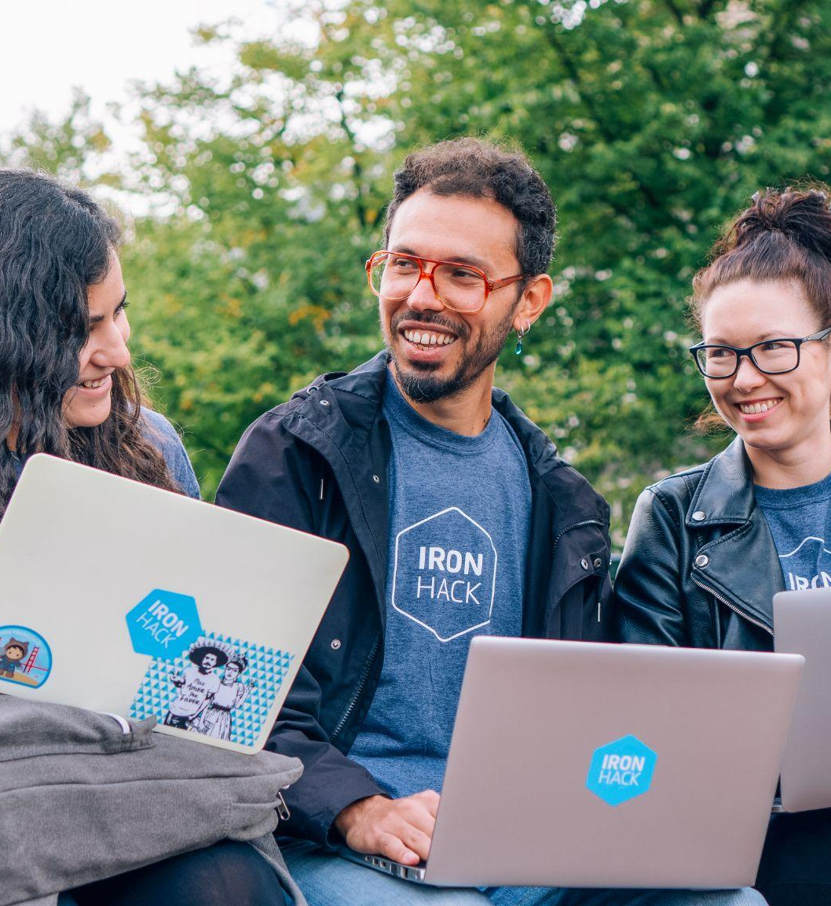
Who am I?
Your job title, i.e. Junior Frontend, UX/UI Designer, Junior Data Analyst, or Cyber security Analyst, etc.
What can I do?
Skill highlights → tech skills + other transferable personal & professional skills from your past experience (check offer)
What else do I bring to the table?
What makes YOU unique
Your motivation?
What am I looking for?
What position are you interested in?
Notes:
Remember that it won’t be perfect from the first try and that it takes some reflecting and definitely some feedback from your Student Success Manager to have a good Summary section. But here are some questions that might serve you as a guideline. Try answering who you are - and remember that as soon as you graduate from your bootcamp, you are no longer a Teacher or a Sales Rep - you are now a Frontend, full stack, junior UXUI designer, Data or Cyber Security Analyst! Exciting right?
Add what technical skills you work with, obviously the ones learned during the bootcamp and specific to your specialization - but also other transferable skills you may bring to the table from either your past jobs or your personality!
And lastly, if possible - try elaborating what position or company type you would like to join. Let’s see some examples for inspiration!

Slide 22
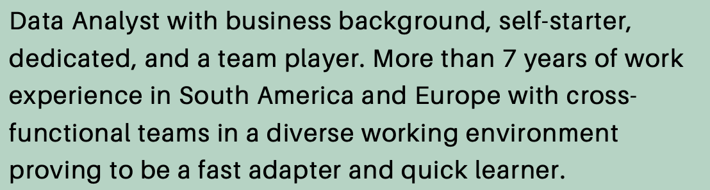
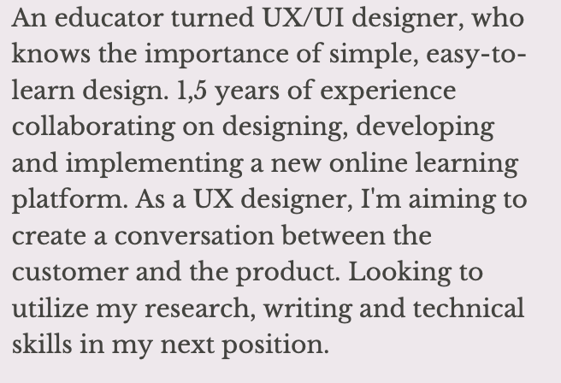
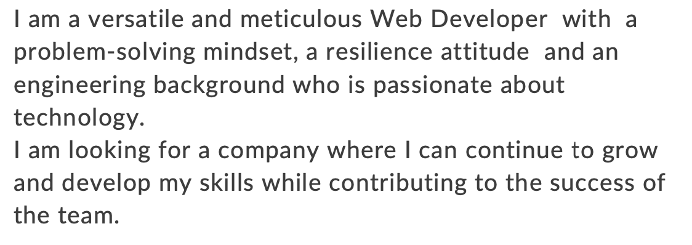
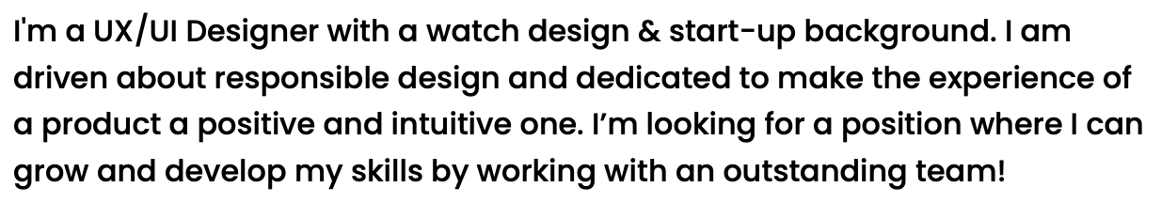
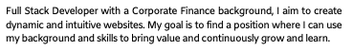
UX/UI
DATA
Ironhacker inspo
WEB
Notes:
Here are some screenshots of other Ironhackers’ Summary sections. As you can see, they’re all different and unique - there’s no perfect formula but if you read carefully - they all mention their target role, what they’re good at, what they will contribute with in a team and what they are seeking. Ready to start working on your own, short and sweet summary section?

Slide 23
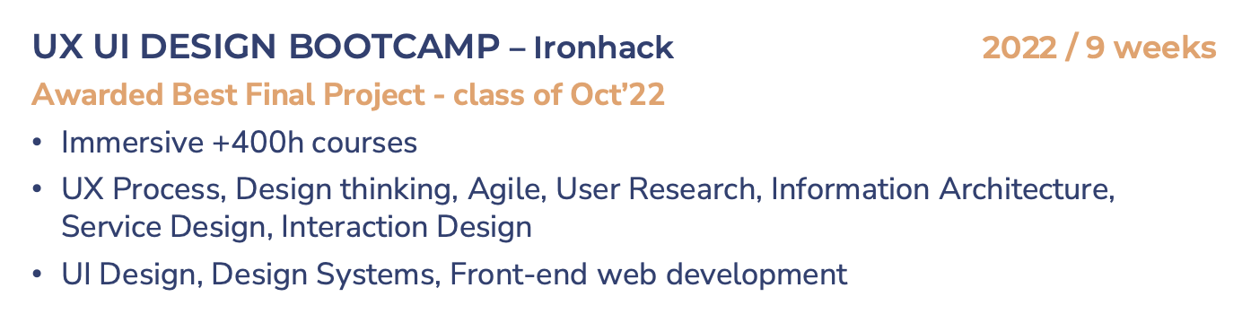
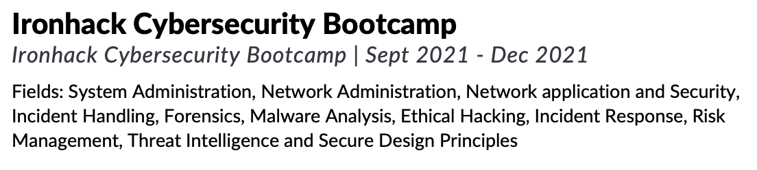
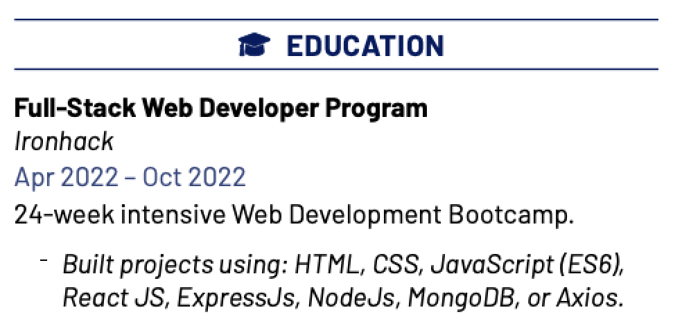
Education
One of the most valuable pieces of your experience as juniors
If you are a Career Changer, it should have a bigger priority in the hierarchy of information
It should have its own section
Don’t forget your keywords
Notes:
Once you graduate, your Ironhack certification will be your most relevant and important educational experience and what will directly enable you to access many of the job opportunities in the tech field.
Therefore, give it the importance it deserves and make it visible and ideally somewhere on the first half of your CV.
Describe the bootcamp including its length, the content, the modules and don’t forget to add the technical keywords such as the technologies you learned!

Slide 24
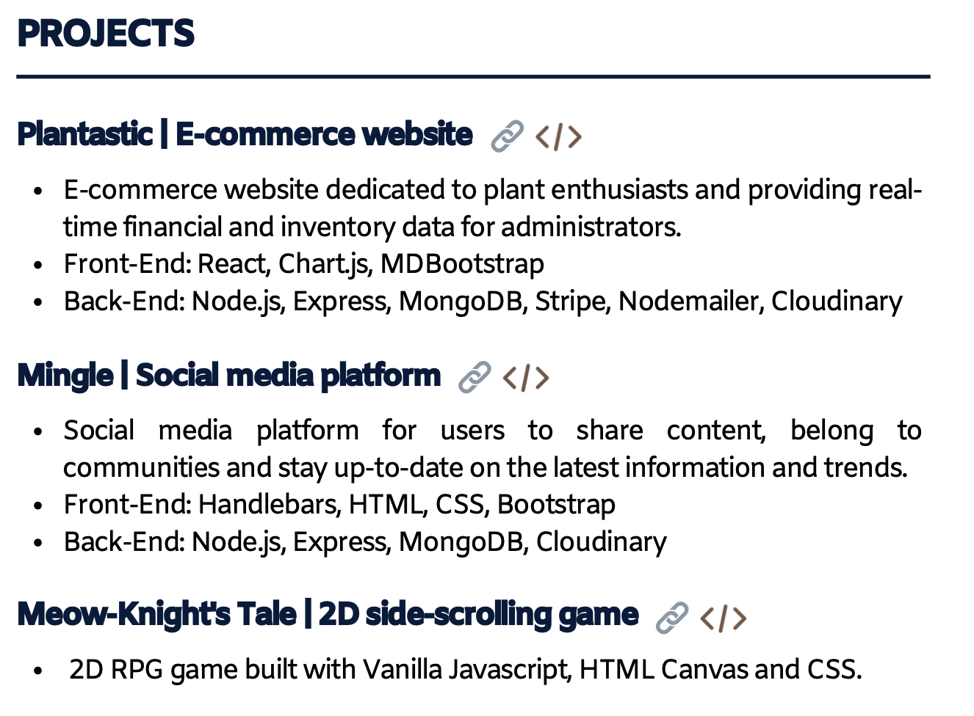
Projects
One of the most valuable pieces of your experience as juniors
Describe your bootcamp
Length
Content
Add keywords
It should have its own section
Ideally add a short description and if applicable, the technologies used
Notes:
Alongside your education - your projects will be key in making your profile look like a better match to recruiters. If you were to focus on your previous work experience, probably unrelated to the tech world - it would most likely make the recruiter believe you’re not such a good fit after all. So let’s prioritise and remember the hierarchy of the information we talked about earlier.
Your projects should have a section of its own and it should ideally contain 2 bullet points - one briefly describing it and the other one highlighting the technologies used to do it.
As said, if you’re a Career Changer, your projects should have a bigger priority but if you worked in a related field before - then of course not. Double check your case with your Student Success Manager for better advice.

Slide 25
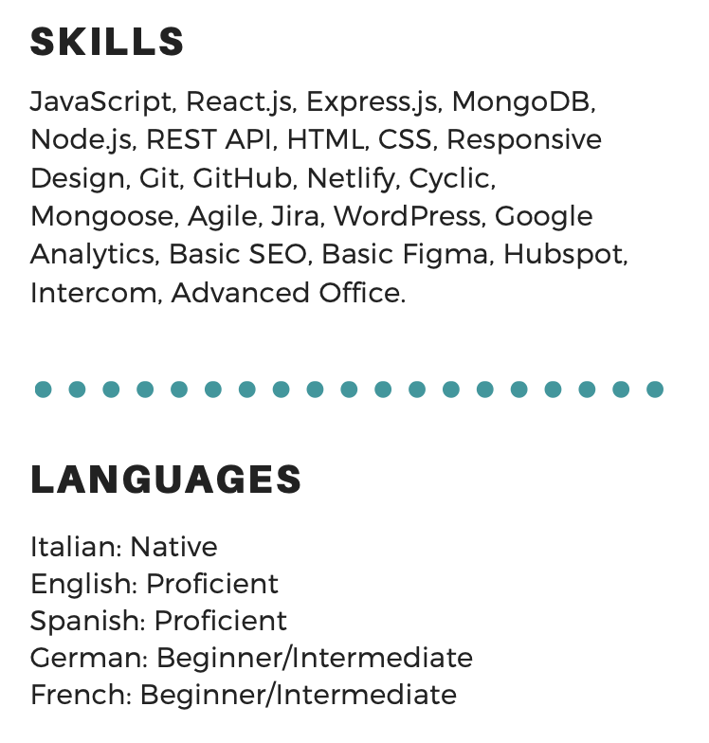
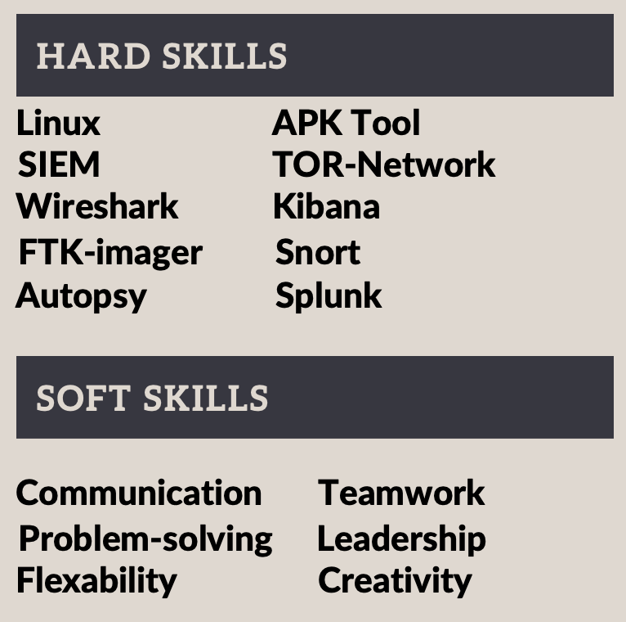
Skills & languages
Add your technical skills (keywords)
Check target role job offers to crosscheck soft skills and choose a few that match your profile
Add your language skills
Notes:
A CV should have a skills section too! Remember that recruiters use keywords to scan through CV’s - so this is a crucial area where we would expect to find these!
Prioritise your technical skills (frameworks, softwares and technologies learned during the bootcamp and other related ones you may have acquired previously) as well as what we call soft skills or personal or professional skills. For that, we recommend checking job offers in your field and see which ones are more demanded - then add those that you feel more related to. Some of the most important ones are communication, teamwork, problem solving, autonomy, creativity and so on. Lastly, don’t forget to add if you speak different languages. If you have certificates that’s great - otherwise what is more important for the hiring team is whether you are a native or fluent speaker.

Slide 26
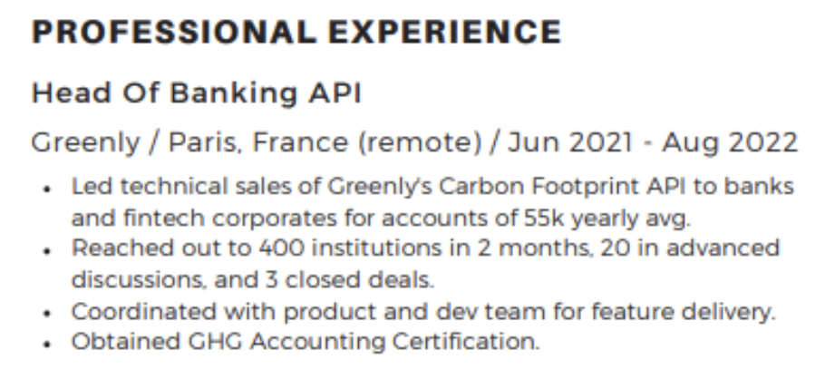
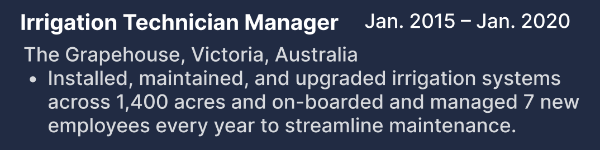
Professional experience
If you are a Career Changer, it should have a smaller priority in the hierarchy of information
If you have experience in a related field - then it should be prioritized!
Add your job title and company name as well as the dates
Keep it short and sweet
You can make use of 2-4 bullet points
Focus on achievements and highlights
If possible, use facts and figures
Transferable skills
Notes:
Lastly, if If you are a Career Changer, meaning that what you did before the bootcamp is not related to your new field of study (for example, if you worked in the tourism sector and you’re now training to become a developer) you should leave your professional experience towards the end of your CV - and instead, highlight your Web Dev bootcamp and projects at Ironhack! If on the contrary, you are a Career Booster - let’s say you worked as a Sales Director but used Tableau to gather insights about business trends in your company - maybe you want to prioritize this a bit more! If you are unsure of your particular case - our recommendation is that you give it a thought first based on all the tips provided in Careerhack and that you then contact your Student Success Manager for a more in-depth review and feedback to help you in your particular situation.
Obviously add your job title, company name and the dates you worked there - and elaborate a really brief description of your main responsibilities without going into too much detail. You should keep it short and sweet - in fact you can use 2 - 4 bullet points and try to focus on your achievements and highlights (for example if you managed X amount of people or dealt with over a 100 clients, were in charge of this and that, etc.) . Oh, and if you can use facts and figures, that’s great! People love numbers!
Also, it’s important that you reflect on the skills that you learned in that job, that may be transferable to your new role as a Web, UXUI Designer, Data or Cyber security analyst!

Slide 27
Thanks!
IRONHACK 2023. ALL RIGHTS RESERVED.

